Slide 1
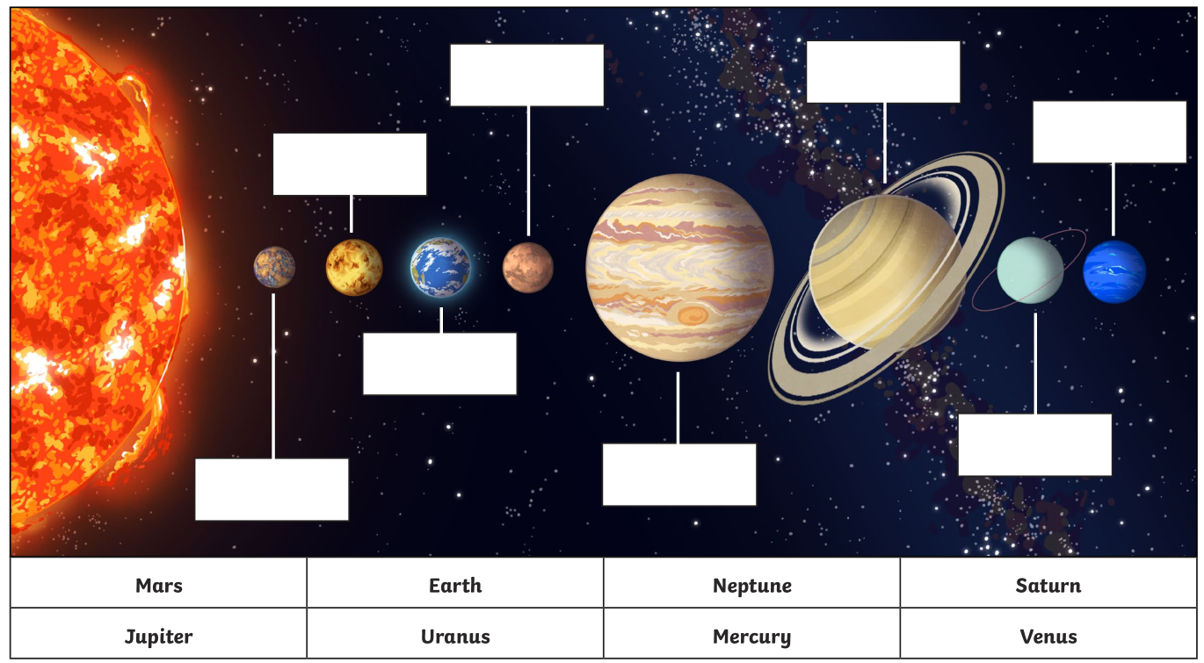


Earth and Space Pre-test
Name: ______________________
Q1. Label the planets in the solar system.
Q2. Draw lines on this picture to show:
the Earth orbiting the Sun, and,
the Moon orbiting the Earth.
Moon
Sun
Earth
Q3. How much time does it take for:
the Earth to orbit the Sun __________________
the Moon to orbit the Earth __________________
the Earth to spin on its axis __________________
Q4. On the picture, label which part of the Earth is in the day and which is at night.
Sun

Slide 2
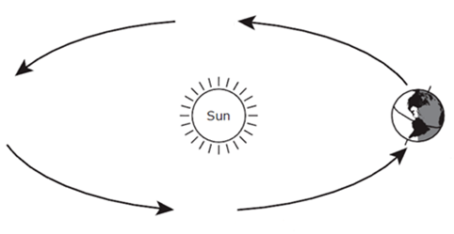
Earth and Space Pre-test
Q5. What causes day and night?
the Sun orbiting the Earth
the Earth rotating on its axis
the Earth orbiting the Sun
the Moon orbiting the Earth
Q6. What season is the Southern Hemisphere experiencing in the diagram below?
Why is it experiencing that season?
Summer Autumn Winter Spring
Equator
North Pole
Southern Hemisphere
Q7. Using the diagram above, describe how much daytime and how much night you would experience at the South Pole and at the Equator.
 | South Pole | At the Equator
Summer
Winter

